Slide 1

School of Computer Technology - George Brown College

Slide 2
Lecture #1 Agenda
Course Instructor
Course Evaluation System
Project Defined
Course Outcomes
Roles and Responsibilities
Project Placement Course Timelines
Topical Outline/Schedule

Slide 3
Course Instructor
No required Textbook for the Capstone Project classes. Reference material will be used by instructor on as required basis.
Lectures and Lab sessions are every week. Your attendance is mandatory. Labs will evolve into working sessions in which you can liaise with your instructor. If you cannot attend CONTACT your instructor.

Slide 4


Slide 5
Project Defined
Work over the two semester capstone will be divided into two phases;
  Research (the organization has a need for the students to conduct research, analysis, development which otherwise may not be done due to resource and/or time issues)
  Hands-on (the students may design a website, web app, mobile app, provide analysis, development work, etc.)

Slide 6
While Working on the Project
There is NO Required compensation for the student’s time. The student acquires EXPERIENCE and EXPOSURE while working on the project.
Students in this course could liaise and associate themselves with an industry sponsor (company, agency, office or organization) from where the particular project shall be drawn from.
While working at such a place, students will draw data and necessary information from various sources (primary and secondary sources) to augment completion of the project.

Slide 7
Capstone Projects Options
A. . Work on an industry partner project, based on availability
  Predefined projects
  Fulfill industry requirements - any project need accepted
  Teams selected by industry
B. Create your own project
  Develop a team
  Define an industry need
  Approach industry partners/sponsors to provide value
  Research to create a real application

Slide 8
B. Creating your Own Projects
Define a need in the market that you would like to explore
Research your area of specialization
Seek to explore issue/challenges/opportunities with requirements gathering, developing, installation, optimization

Slide 9
Project Deliverables
Project Vision Document - The purpose of this Project Vision document is to propose a solution which would enable the partner organization to achieve their goals
Project Plan and Team Charter
Analysis and Design Assignment
Prototypes/Mock-ups
---------------------------------------------------------------------------
Requirements Management (Business, User, Solution, and Implementation)
Presentations

Slide 10
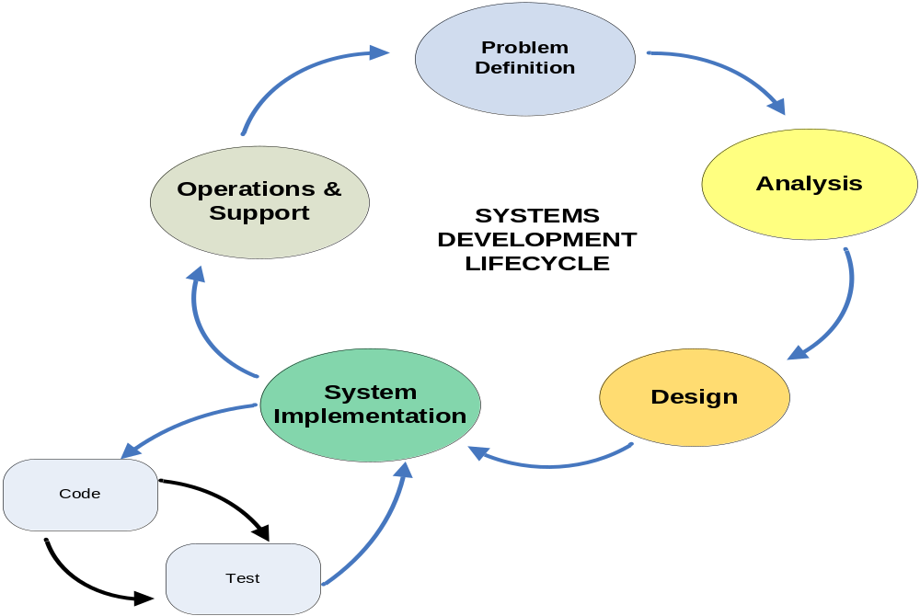
Systems Development Lifecycle
Notes:
LECTURE GUIDELINES
Briefly describe each phase of the lifecycle.
Provide students with handout and walkthrough it.

Slide 11
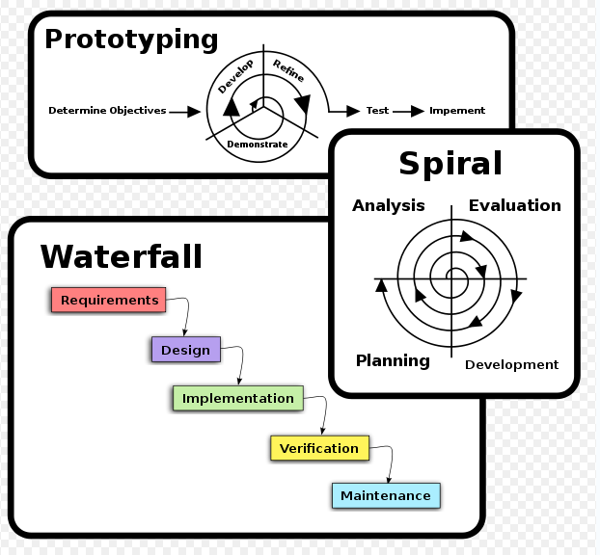
Software Development Methodologies
* Graphic source: wikipedia, software development methodology
Notes:
For each methodology classification:
Provide a definition
List the pros/cons
Identify when it should be used/not be used
Provide an example of each

Slide 12
Project Teams
You will be allowed to pick your own teams
  teams of 4 optimally
ENSURE that your team members are in your section
Exceptions, if any, will be at the discretion of the professor.
Remember, you will be working closely with these team members over the next 30 weeks…

Slide 13

See Course Outline

Slide 14
Roles and
Responsibilities
LEARNERS
Strive to manage learning while balancing work and/or home responsibilities
Take responsibility for the quality of assignments and group work. Running out of time, not reading guidelines of assignments or missing classes is generally reflected in the evaluation results.
Use research techniques for gathering effective evidence/information
Do your fair share of work in group projects.
Apply concepts of human relations and behaviors to working teams and form an effective project team
Demonstrate leadership skills
Communicate effectively

Slide 15
Roles and
Responsibilities
PROFESSOR
Construct an environment conducive to learner success
Deliver instruction based on adult learning characteristics and principles
Liaise with individual learners and learner groups to ensure that all learners are participating and maintaining professional standards
Respond quickly and effectively to any concerns that the students identify and resolve.
Discuss/share in lecture periods any information that is conducive to learner success.

Slide 16
Tips for Student Success
Attitude is everything. Observe your feeling and your actions – always.
Develop a strong support system, and support it.
Be present in mind, body, and spirit.
Participate in class. Your contribution stimulates ideas and energies in your learning environment.
Think about how to apply your knowledge in your own experiences and environments.
Be an effective team member.
Take ownership of the project.
Show commitment towards the team work.

Slide 17


